Slide 1
Safeguarding Your Community: Opioid overdose ReSponse With naloxone
Customize this cover slide with your school name, presentation date, school logo, etc., as desired.
Notes:
Notes:
This presentation is intended for use with school communities to raise awareness of the drug overdose crisis and what the community can do to prevent drug overdose, with a special focus on the opioid overdose reversal medication, naloxone.
Customize this cover slide with your school name, presentation date, school logo, etc., as desired.
Brief, sample discussion points, and notes to presenters are included in this presentation (in notes) in select slides for reference, and may be customized, as needed. This presentation was developed in June 2023.
As some new data are released annually, please review/update slides accordingly to ensure the most up-to-date data/content are presented.

Slide 2
Contents
Scope of the problem: The drug overdose crisis
Drug use and drug overdose among teens
What is fentanyl
What can our community do to prevent drug overdose in teens?
Good Samaritan Laws
Educational resources
Questions
Notes:
Discussion Points:
School nurses are leaders in student health and have the education and expertise to assist the community and school leadership in assessing the need for and implementing a campus naloxone program to address drug overdoses in schools and/or in the community. Synthetic opioids like fentanyl have been contributing to increases in drug overdose deaths in the past decade, even among young people. Naloxone is an emergency medication school nurses can administer to save lives by quickly reversing drug overdoses caused by opioids.
In this presentation, we will discuss the drug overdose crisis, its effects on young people, signs of an overdose and how to respond to an overdose. We’ll also cover how synthetic opioids have contributed to increases in overdose deaths, as well as the life-saving opioid overdose reversal medication, naloxone.

Slide 3
Scope of the problem: The drug overdose crisis

Slide 4
The Drug Overdose Crisis
More than 106,000 persons in the U.S. died from drug-involved overdose in 2021, including illicit drugs and prescription opioids.
National Drug-Involved Overdose Deaths*, Number Among All Ages, by Gender, 1999-2021
*Includes deaths with underlying causes of unintentional drug poisoning (X40–X44), suicide drug poisoning (X60–X64), homicide drug poisoning (X85), or drug poisoning of undetermined intent (Y10–Y14), as coded in the International Classification of Diseases, 10th Revision.
(Centers for Disease Control and Prevention [CDC], National Center for Health Statistics [NCHS] 2023)
Notes:
Discussion Points:
Drug overdose deaths have greatly increased among young people and other community members over the last decade.
This figure from the National Institute on Drug Abuse highlights the more than 106,000 drug-involved overdose deaths in 2021.

Slide 5
The Drug Overdose Crisis
National Drug-Involved Overdose Deaths*, Number Among All Ages, 1999-2021
*Includes deaths with underlying causes of unintentional drug poisoning (X40–X44), suicide drug poisoning (X60–X64), homicide drug poisoning (X85), or drug poisoning of undetermined intent (Y10–Y14), as coded in the International Classification of Diseases, 10th Revision.
(CDC/NCHS, 2023)
Notes:
Discussion Points:
Synthetic opioids, like illegally produced fentanyl, have been driving much of the surge in drug overdose deaths in the past several years. This second figure from the National Institute on Drug Abuse shows the continued increase of deaths from synthetic opioids other than methadone (involving primary fentanyl).
These synthetic opioids may be consumed (knowingly or unknowingly) by young people when mixed into or sold as other drugs like heroin, cocaine, or counterfeit pills. Because a lethal dose of fentanyl can be very small, using drugs contaminated with or replaced by fentanyl can increase the likelihood of an overdose.
We will talk more about synthetic opioids in the coming slides.

Slide 6
Drug overdose deaths increased by 30% from 2019 to 2020, and again by 15% in 2021, resulting in more than 106,000 deaths in 2021 alone.
(CDC, 2023)
Notes:
Discussion Points:
More than 100,000 people died from a drug overdose in 2021, a 15% increase from the year prior.
The rise in opioid deaths in America occurred in three distinct waves.
The 1990’s marked a rise in prescription opioid overdose deaths. Next, in 2010, heroin overdose deaths rose. Lastly, in 2013, synthetic opioids such as illicitly made fentanyl resulted in a rise in synthetic opioid overdose deaths

Slide 7
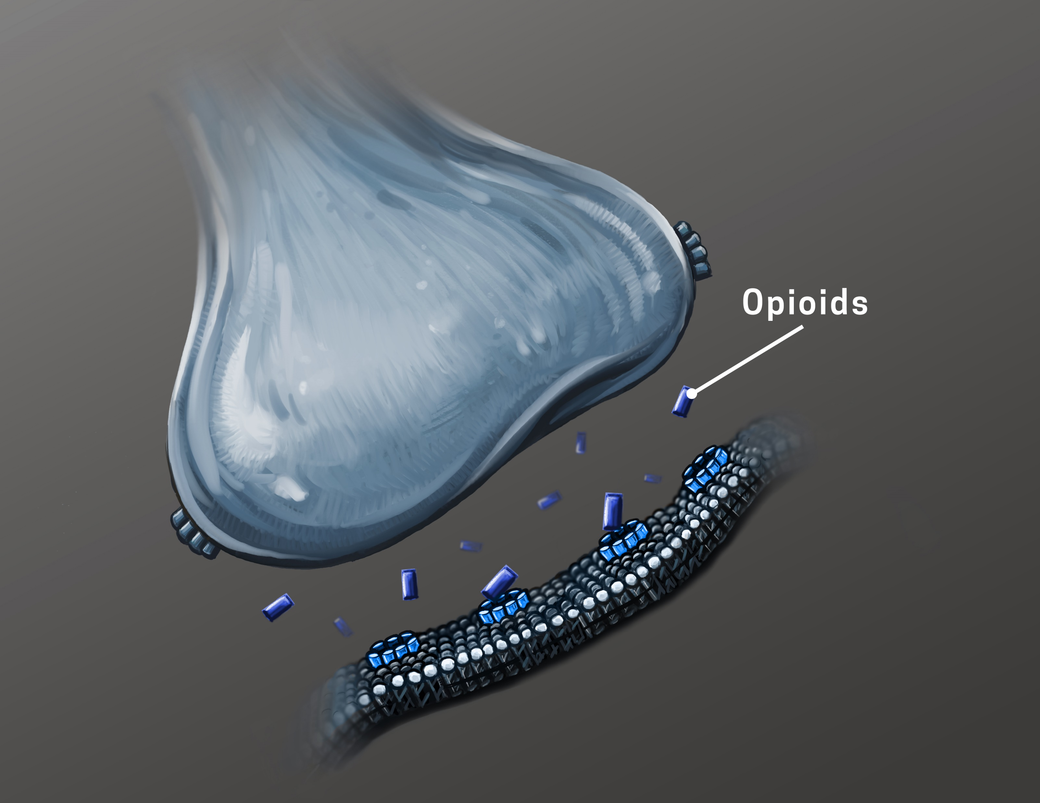
What are opioids?
Opioids bind to receptors in the brain that reduce the body’s perception of pain and create feelings of relaxation and pleasure.
Taking opioids regularly can lead to an opioid use disorder.
NIDA Flickr, https://flic.kr/p/2kcLpWE
Opioids include:
Heroin
Synthetic opioids like fentanyl
Prescription pain medications like codeine, hydrocodone, hydromorphone, meperidine, morphine, oxycodone
(NIH/NIDA, 2020, 2021a; n.d.c)
Notes:
Discussion Points:
Opioids are medications that bind to specific receptors in the brain that reduce the transmission of pain signals throughout the body. When a person continues to take opioids, the brain adapts and the person no longer receives pleasure from anything except the drug. As a result, more of the drug is needed to obtain a sense of pleasure.
Opioids are a class of drugs that include the illegal drug heroin, synthetic opioids that are legally or illegally produced such as fentanyl, and pain relievers available legally by prescription, such as oxycodone (OxyContin®), hydrocodone (Vicodin®), codeine, morphine, and many others.
Content Sources:
https://nida.nih.gov/research-topics/opioids
https://nida.nih.gov/research-topics/commonly-used-drugs-charts#prescription-opioids
https://nida.nih.gov/publications/drugfacts/prescription-opioids
Graphic Source: NIDA Flickr, https://flic.kr/p/2kcLpWE

Slide 8
Drug use and drug overdose among teens

Slide 9
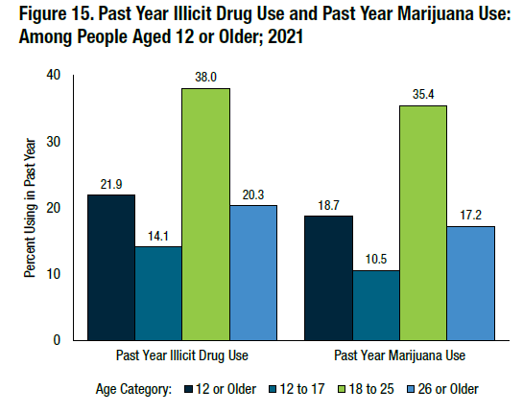
Drug Use Among Young People: Facts & Statistics
3.7 Million Adolescents
(Miech et al., 2023, Substance Abuse and Mental Health Services Administration [SAMHSA], 2023)
Notes:
Discussion Points:
Drug use is a high-profile public health concern among young people, with 14.1% (or 3.7 million) of adolescents aged 12-17 years old reporting past-year illicit drug use in 2021.
Content and graphic source: https://www.samhsa.gov/data/sites/default/files/reports/rpt39443/2021NSDUHFFRRev010323.pdf - PDF page 16
**********************************************************
Additional statistics could be included on this slide:
In 2022, 11% of eighth graders, 21.5% of 10th graders, and 32.6% of 12th graders reported any past-year illicit drug use.
Content sources
https://nida.nih.gov/news-events/news-releases/2022/12/most-reported-substance-use-among-adolescents-held-steady-in-2022
https://monitoringthefuture.org/wp-content/uploads/2022/12/mtf2022.pdf (MTF data tables - 4-2)

Slide 10
Adolescent Overdose Deaths are Increasing
Overdose deaths have increased among adolescents aged 10-19:
(July – December 2019 to July – December 2021)
109% - median monthly overdose deaths
182% - deaths involving illicitly manufactured fentanyl (IMFs)
90% - deaths involving opioids
84% - deaths involving IMFs
25% - deaths where counterfeit pills were present
(Tainz, et al, 2022)
Overdose can happen to anyone! Only 35% of the young people who died had a known history of opioid use.
Notes:
Discussion Points:
This slide shows how much overdose deaths have increased among teens aged 10-19 years old.
A large takeaway from this slide is that overdose can happen to anyone! Only 35% of the young people who died had a known history of opioid use.

Slide 11
What is fentanyl?

Slide 12
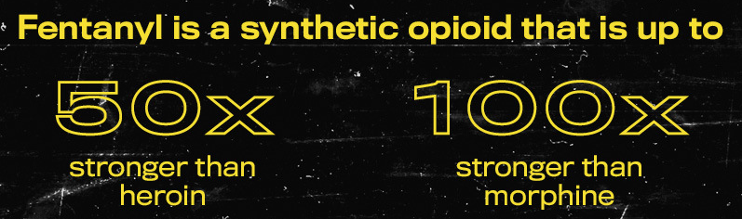
One of the most common drugs involved in drug overdose deaths in the United States.
Can be prescribed but is also made illegally.
Inexpensive to manufacture.
Can be mixed with other drugs (i.e., heroin, cocaine, meth, pressed pills); a person may not know that it’s been added, leading them to underestimate how much opioids they are taking and increase chance of overdose.
It is almost impossible to know whether a drug contains fentanyl just by looking at it.
Test strips can help determine if fentanyl is present in a drug.
Naloxone can stop a drug overdose from opiods,
including fentanyl
(CDC, 2022; 2023A; NIH/NIDA, 2021b)
Notes:
Discussion Points:
Fentanyl is a very powerful synthetic opioid
It is one of the most common drugs involved in drug overdose deaths in the United States
It can be prescribed but is also made illegally.
It is inexpensive to manufacture because its components are easy to get and are concentrated
It can also be mixed with other drugs (i.e., heroin, cocaine, meth, pressed pills); a person may not know that it’s been added, leading them to underestimate how much opioids they are taking and increase chance of overdose.
It is almost impossible to know whether a drug contains fentanyl
But remember, naloxone can stop a drug overdose from opioids, including fentanyl.
Content source*:
https://nida.nih.gov/publications/drugfacts/fentanyl
https://www.cdc.gov/stopoverdose/fentanyl/index.html
https://www.cdc.gov/stopoverdose/fentanyl/fentanyl-test-strips.html
*
Image source: https://www.cdc.gov/stopoverdose/fentanyl/index.html

Slide 13
Fentanyl mixed into other drugs is a driver of teen overdose deaths
Counterfeit pills:
Resemble prescription drugs
Have become more common
Have increased fatal overdose risk among teens
Are easy to buy online
Were involved in nearly 25% of overdose deaths from 2019 to 2021
(CDC, 2023)
Retrieved from Flipboard.com
Notes:
Discussion Points:
Counterfeit pills that resemble prescription drugs but contain illicitly manufactured fentanyl have become more common and have increased fatal overdose risk among teens, in part due to the ease of purchasing these pills online.
Remember the statistics from a few slides back:
84% overdose deaths among teen (10–19 years old) involved illicitly manufactured fentanyl (July – December 2019 to July – December 2021).
Counterfeit pills were involved in nearly 25% of overdose deaths. (July – December 2019 to July – December 2021)
Content Source: https://www.cdc.gov/mmwr/volumes/71/wr/mm7150a2.htm

Slide 14
Too much of any opioid, including prescription opioids or illicitly manufactured opioids, leads to slowed breathing, resulting in too little oxygen reaching the brain—known as hypoxia.
Hypoxia can lead to coma, permanent brain damage, or death.
(NIDA, 2022)
Notes:
Discussion Points:
It is vital to understand that an opioid overdose (either from prescribed medications or illicitly manufactured) decreases respirations and if not reversed, will cause death quickly.
Opioid misuse can cause slowed breathing, which can cause hypoxia, a condition that results when too little oxygen reaches the brain. Hypoxia can have short- and long-term psychological and neurological effects, including coma, permanent brain damage, or death.
Content Source: https://nida.nih.gov/publications/drugfacts/prescription-opioids

Slide 15
What can our community do to prevent drug overdose in teens?

Slide 16
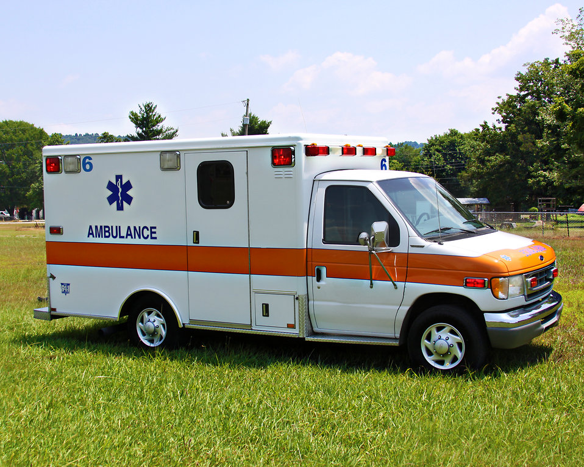
What Is an Opioid Overdose?
Someone is exposed to a dose of opioids too strong for their body to process
Slow breathing or no breathing
Hypoxia (not enough oxygen getting to the brain)
Psychological/neurological effects, coma, permanent brain damage, or death
(NIH/NIDA, 2021a)
Notes:
Discussion Points:
First, it is important to understand what an opioid overdose is.
Content source*: https://nida.nih.gov/publications/drugfacts/prescription-opioids

Slide 17
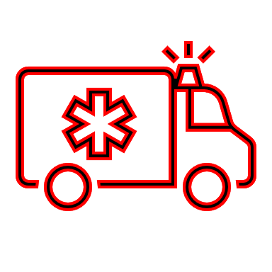
Recognize the Difference: Opioid Intoxication vs. Opioid Overdose
Call 911 immediately!
Opioid Intoxication | Opioid Overdose
Relaxed muscles | Pale, clammy skin
Slowed or slurred speech, slowed or shallow breathing | Speech infrequent, not breathing, very shallow breathing
Appears sleepy | Deep snorting or gurgling
Responds to stimuli (shaking, sternal rub) | Unconscious and unresponsive to stimuli (calling name, shaking, sternal rub); limp body
Normal heart rate/pulse | Slowed heart rate/pulse
Normal skin color | Cyanotic skin coloration (blue lips, fingertips)
Notes:
Discussion Points:
It is also important to recognize the signs of an overdose.
Understanding the difference between opioid intoxication and opioid overdose can be life-saving.
If you see a person exhibiting symptoms of an opioid overdose, call 911 for help immediately.
Content sources:
https://www.cdc.gov/drugoverdose/pdf/patients/Preventing-an-Opioid-Overdose-Tip-Card-a.pdf
https://www.mass.gov/doc/core-competencies-for-intra-nasal-naloxone-distribution-pilot-program-participants/download

Slide 18
Learn About Naloxone
Naloxone:
Is a life-saving medication that restores normal breathing
Rapidly reverses an overdose from opioids (e.g., heroin, fentanyl, and prescription opioid medications) when given in time
Only works for 30-90 minutes; multiple doses may be needed, and emergency medical care should be sought even if overdose symptoms resolve
There are two forms of naloxone:
Nasal spray
Injectable
The NARCAN brand nasal spray was approved for non-prescription use in 2023.
Anyone can administer naloxone. Medical training or authorization is NOT required.
(CDC, 2023b)
Notes:
Discussion Points:
Naloxone is a life-saving medication that can rapidly reverse an overdose from opioids—including heroin, fentanyl, and prescription opioid medications—when given in time.
According to the National Institute on Drug Abuse, “Naloxone can quickly restore normal breathing to a person if their breathing has slowed or stopped because of an opioid overdose. Naloxone only works in the body for 30 to 90 minutes. It is possible for a person to still experience the effects of an overdose after naloxone wears off or need multiple doses if a potent opioid is in a person’s system.”
There are 2 forms of naloxone that anyone can use without medical training or authorization--a nasal spray and injectable.
Injectable brands of naloxone are typically drawn up from a vial, though one brand offers a prefilled syringe. Naloxone is usually injected into muscle.
Naloxone is available in all 50 states
In 2023, the U.S. Food and Drug Administration approved NARCAN, 4 milligram (mg) naloxone hydrochloride nasal spray for over-the-counter (OTC), nonprescription, use.
Note that NARCAN is not the only formulation and brand name for naloxone; however, many people incorrectly still refer to all naloxone products as “NARCAN.”
Anyone can administer naloxone; no formal training is required. Instructions for use are included with each dose in the packaging, and should be followed for proper administration.
Content sources:
https://www.cdc.gov/stopoverdose/naloxone/index.html
https://www.fda.gov/news-events/press-announcements/fda-approves-first-over-counter-naloxone-nasal-spray
https://nida.nih.gov/publications/drugfacts/naloxone
Graphic source:
https://www.cdc.gov/stopoverdose/naloxone/index.html

Slide 19
Understand That Naloxone Should Be Given as Soon as Possible
Naloxone should be administered IMMEDIATELY.
Naloxone is the first line treatment for opioid overdose.
While naloxone does not reverse overdoses caused by tranquilizers (e.g., xylazine), stimulants, and other classes of drugs, naloxone should still be given if drug overdose is suspected in case opioids may be involved.
After administering naloxone, the responder (e.g., school nurse) should stay with the person until emergency help arrives.
(CDC, 2023B; NIH/NIDA, 2022, n.d.a; SAMHSA, 2018; Scott County Iowa, 2022; U.S. Food & Drug Administration, 2022)
Notes:
Discussion Points:
It should be administered IMMEDIATELY
Naloxone is the first line treatment for opioid overdose
Naloxone should always be given in suspected cases of overdose with tranquilizers, benzodiazepines, or stimulants because they are frequently combined with opioids; however, naloxone will only reverse the effects of opioid overdose.
It’s important to note that xylazine has been linked more and more to opioid overdose deaths as people are consuming it – knowingly or unknowingly—when it is added to illicit opioids. It is recommended to administer naloxone to reverse the effects of the opioid, though the effects from xylazine on breathing will not be reversed by naloxone.
After administering naloxone, the responder should stay with the person until emergency help arrives or for at least four hours to make sure their breathing returns to normal.
Content Sources*:
https://www.cdc.gov/stopoverdose/naloxone/index.html; primary: https://store.samhsa.gov/sites/default/files/d7/priv/sma18-4742.pdf
https://nida.nih.gov/publications/drugfacts/naloxone
https://www.fda.gov/drugs/drug-safety-and-availability/fda-alerts-health-care-professionals-risks-patients-exposed-xylazine-illicit-drugs
https://nida.nih.gov/research-topics/xylazine
Image Source:
https://www.cdc.gov/stopoverdose/naloxone/index.html

Slide 20
Learn About Naloxone Safety
Naloxone is a safe drug.
If the person has not overdosed on an opioid, naloxone has no effect on the body!
The risk of death from an opioid overdose is much greater than the risk of side effects from naloxone.
There are virtually no adverse health effects from naloxone.
(CDC, 2023b)
Notes:
Discussion Points:
Parents & school administrators should not be concerned about adverse health effects of naloxone
The risk of death from an opioid overdose is much greater than the risk of side effects from naloxone.
There are virtually no adverse health effects from naloxone.
If the person has not overdosed on an opioid, naloxone has no effect on the body!
Content Sources*:
https://nida.nih.gov/publications/drugfacts/naloxone
*Reminder for NASN—please cite original sources, as appropriate
Image Source:
https://www.cdc.gov/stopoverdose/naloxone/index.html

Slide 21
Know What To Do In Case Of A Suspected Overdose
Evaluate for signs of overdose
1
Call 911
2
Administer Naloxone*
3
Support Breathing
4
Monitor for Response
5
*If the person is not responsive within 2-3 minutes after administering the first dose of naloxone, give the person a second dose of naloxone.
(SAMHSA, 2023)
Notes:
Discussion Points:
An opioid overdose requires immediate medical attention. An essential step—after evaluating for signs of an overdose—is to get help from someone with medical expertise as soon as possible. Call 911 immediately if you see the signs of an overdose we discussed earlier like if a person is not breathing, or they are unresponsive. Tell the dispatcher that someone is unresponsive and not breathing and provide an address or location so they can easily locate you. Next, administer naloxone following the packaging instructions. If needed, support breathing by giving CPR if you are trained or perform rescue breathing. Even if the person seems to get better, make sure they are transported to the nearest medical facility. Stay with them until help arrives. If the person is not responsive within 2-3 minutes after administering the first dose of naloxone, give the person a second dose of naloxone.
For more information on how to perform these steps, see the Injectable Naloxone Administration Protocol, the Nasal Naloxone Administration Protocol, and the Naloxone Training for School Staff PowerPoint Presentation. [insert instructions on how to access these resources once live]
Content source: https://store.samhsa.gov/sites/default/files/d7/priv/five-essential-steps-for-first-responders.pdf

Slide 22
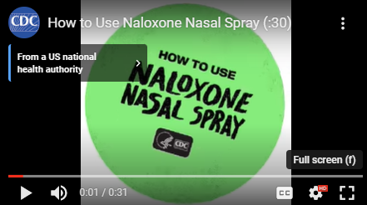
Know How To Administer Naloxone Nasal Sprays
Video 1: CDC, 2023. Retrieved from https://www.cdc.gov/stopoverdose/naloxone/index.html
Notes:
Discussion Points:
This video from CDC highlights how to use nasal naloxone.
Note: Presenter – the graphic on this slide hyperlinks to the video: https://youtu.be/odlFtGNjmMQ. You may also embed the video on the slide to facilitate your presentation.
Content and graphic (screenshot) source: https://www.cdc.gov/stopoverdose/naloxone/index.html

Slide 23
Know How To Administer Naloxone Injectables
Video 2: CDC, 2023. Retrieved from https://www.cdc.gov/stopoverdose/naloxone/index.html
Notes:
Discussion Points:
This video from CDC highlights how to use injectable naloxone.
Note: Presenter – the graphic on this slide hyperlinks to the video: https://youtu.be/zvVLygabkNA. You may also embed the video on the slide to facilitate your presentation.
Content and graphic (screenshot) source: https://www.cdc.gov/stopoverdose/naloxone/index.html

Slide 24
Good Samaritan Laws

Slide 25
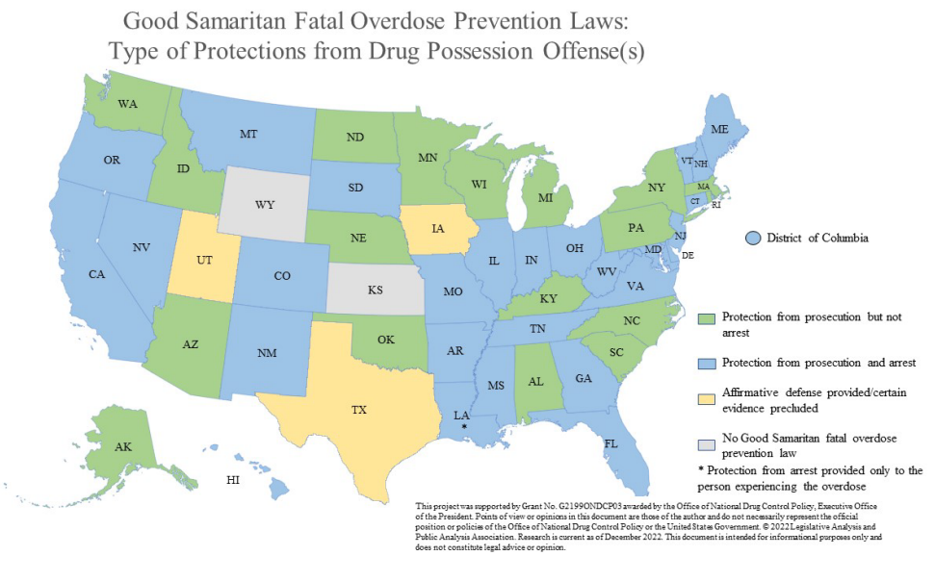
Be Aware Of Good Samaritan Laws
Protects people from prosecution or arrest if they call 911 to save the life of someone experiencing an overdose.
These laws may also protect the person who is experiencing an overdose.
(Legislative Analysis and Public Policy Association, 2022)
Notes:
Discussion Points:
How do state good Samaritan laws affect naloxone in schools programs?
As of December 2022, 47 states and the District of Columbia have Good Samaritan fatal overdose prevention laws. Only Kansas and Wyoming do not have such laws. Additionally, none of the other U.S. territories has a Good Samaritan fatal overdose prevention law in place.
States have implemented laws to make it easier for first responders and the general public to obtain naloxone (for example, making formulations available over the counter). Additionally, to encourage people to assist an individual who is or may be experiencing an overdose, most states also enacted laws which protect laypeople who administer naloxone, in good faith, in an emergency from civil and/or criminal liability. The Legislative Analysis and Public Policy Association (LAPPA) undertook an extensive research project to determine the current status of naloxone access laws throughout the United States, including the District of Columbia and all U.S. territories. As of August 2020, all 50 states and the District of Columbia have some form of a naloxone access law. The laws vary significantly by state.
Content sources:
http://legislativeanalysis.org/wp-content/uploads/2022/12/Good-Samaritan-Fatal-Overdose-Prevention-And-Drug-Induced-Homicide-Summary.pdf
https://legislativeanalysis.org/naloxone-summary-of-state-laws/
Graphic source: http://legislativeanalysis.org/wp-content/uploads/2022/12/Good-Samaritan-Fatal-Overdose-Prevention-And-Drug-Induced-Homicide-Summary.pdf

Slide 26
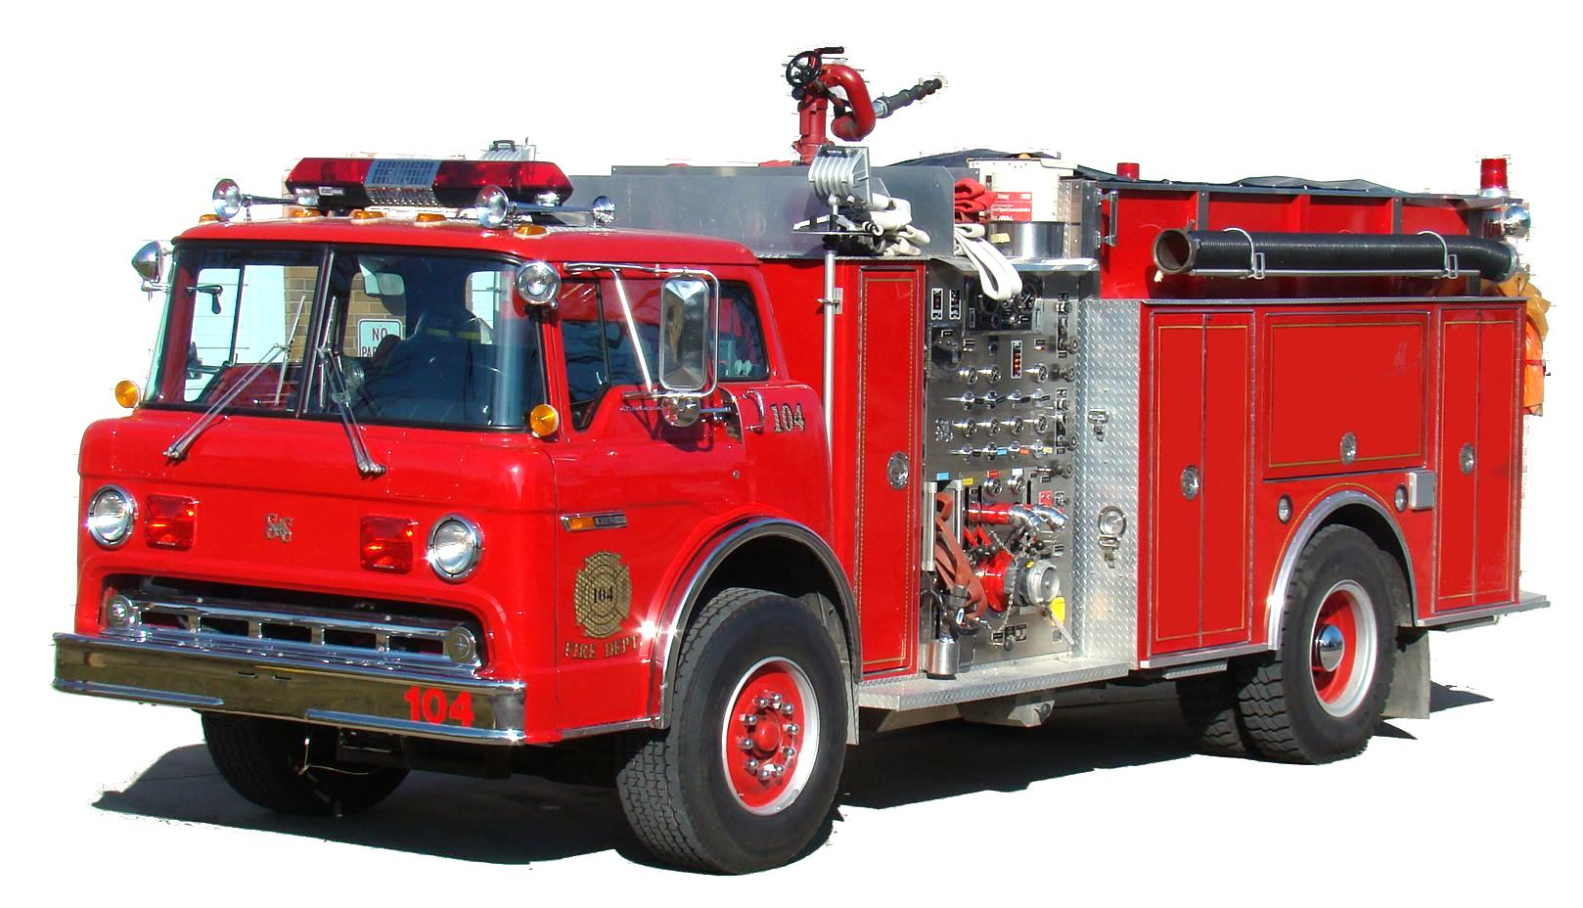
Be Aware Of Community Access To Naloxone
Where is naloxone available in our community?
EMS
Police
Schools
Add image of a local school
Notes:
Customize this slide to:
Add information on where naloxone is available in your community- does EMS/police carry the drug? Update pictures accordingly.
Will naloxone be available in the schools? If so, add picture of one of the schools

Slide 27
Promote Awareness Of Safe Storing And Disposing Of Prescription Opioids
Notes:
Discussion Points:
Promoting awareness of the importance of safely storing opioid medications and disposing of unused opioids is another key step to keeping communities safe.
Free PSAs to share with the community are available through the Remove the Risk Campaign toolkit from FDA. These include social media images, fact sheets, videos, and more.
Graphic source: https://www.fda.gov/drugs/safe-disposal-medicines/safe-opioid-disposal-remove-risk-outreach-toolkit

Slide 28
Educational Resources

Slide 29
Resources to Support Additional Education
Visit the NASN Naloxone Toolkit landing page [hyperlink once finalized] for additional resources, including:
Sample Policies and Policy Development Resources
Sample Protocols and Protocol Development Resources
Overdose, Naloxone, and Opioids Education
Substance Use Treatment Resources
Communication Resources
(NASN, 2023)
Notes:
Graphic source (screenshot): https://nida.nih.gov/research-topics/parents-educators

Slide 30
Questions?

Slide 31
Thank you!
PRESENTER NAME
CONTACT INFORMATION
Notes:
Add your name and contact information here and any other resources.

Slide 32
References
Adamis Pharmaceuticals Corp. (2019) https://zimhi.com/wp-content/uploads/2022/03/ZIMHI-Prescribing-Information.pdf
Amphastar Pharmaceuticals, 2016 - https://amphastar.com/assets/naloxone_9-182.pdf
Centers for Disease Control and Prevention. (2023) Overdose Graphics. Retrieved from
https://www.cdc.gov/drugoverdose/resources/graphics/overdose.html
Centers for Disease Control and Prevention. (2023) Synthetic Opioid Overdose Data. Retrieved from
https://www.cdc.gov/drugoverdose/deaths/synthetic/index.html
Centers for Disease Control and Prevention. (2023) Fentanyl Facts. Retrieved from
https://www.cdc.gov/stopoverdose/fentanyl/index.html
Centers for Disease Control and Prevention. (2023) Fentanyl Test Strips: A Harm Reduction Strategy. Retrieved from
https://www.cdc.gov/stopoverdose/fentanyl/fentanyl-test-strips.html
Centers for Disease Control and Prevention. (2023) Life Saving Naloxone. Retrieved from
https://www.cdc.gov/stopoverdose/naloxone/index.html
Enteen L, Bauer J, McLean R, et al. Overdose prevention and naloxone prescription for opioid users in San Francisco. J Urban Health.
2010;87(6):931-941. doi:10.1007/s11524-010-9495-8
Emergent Devices Inc. (2022) Narcan Nasal Spray 4 mg. https://www.narcan.com/frequently-asked-questions/
Hikma Pharmaceuticals USA Inc. (2023) https://kloxxado.com/faqs/
Legislative Analysis and Public Policy Association. (2022) Good Samarititan Fatal Overdose Prevention and Drug Indiced Homicide:
Summary of State Laws. https://zimhi.com/patients-and-caregivers/how-to-use-zimhi/
National Institute of Drug Abuse, National Institute of Health (2023) Opioids. Retrieved from
https://nida.nih.gov/research-topics/opioids
National Institute of Drug Abuse, National Institute of Health (2023) Commonly Used Drug Charts. Retrieved from
https://nida.nih.gov/research-topics/commonly-used-drugs-charts#prescription-opioids
National Institute of Drug Abuse, National Institute of Health (2023) Prescription Opioids Drug Facts. Retrieved from
https://nida.nih.gov/publications/drugfacts/prescription-opioids
National Institute of Drug Abuse, National Institute of Health (2023) Drug Overdose Death Rates. Retrieved from
https://nida.nih.gov/research-topics/trends-statistics/overdose-death-rates

Slide 33
References
National Institute of Drug Abuse, National Institute of Health (2023) Naloxone Drug Facts. Retrieved from
https://nida.nih.gov/publications/drugfacts/naloxone
National Institute of Drug Abuse, National Institute of Health (2023) Xylazine. Retrieved from
https://nida.nih.gov/research-topics/xylazine
National Institute of Drug Abuse, National Institute of Health (2023) Parents and Educators. Retrieved from
https://nida.nih.gov/research-topics/parents-educators
National Institute of Neurological Disorders and Stroke. (2023) Cerebral Hypoxia. Retrieved from
https://www.ninds.nih.gov/health-information/disorders/cerebral-hypoxia
National Library of Medicine. (2017) Emergency Medical Service Response Times In Rual, Suburban, and Urban Areas. JAMA
Surgery 2017Juy 19.DOI: 10.1001/jamasurg.2017.2230. Retrieved from https://www.ncbi.nlm.nih.gov/pmc/articles/PMC5831456/
Massachusette Department of Public Health. (n.d.) Opioid Overdose Education and Naloxone Distribution: MDPH Naloxone Pilot
Program and Core Competencies. Retrieved from https://www.mass.gov/doc/core-competencies-for-intra-nasal-naloxone-distribution-pilot-program-participants/download
Substance Abuse and Mental Health Services Administration. Department of Health and Human Services. (2023) SAMSHA- Opioid
Overdose Prevention Toolkit. Retrieved from https://store.samhsa.gov/sites/default/files/d7/priv/sma18-4742.pdf
Substance Abuse and Mental Health Services Administration. Department of Health and Human Services. (2023) SAMSHA- Opioid
Overdose Prevention Toolkit- Feive essential Steps for Responders. Retrieved from https://store.samhsa.gov/sites/default/files/d7/priv/five-essential-steps-for-first-responders.pdf
Tanz LJ, Dinwiddie AT, Mattson CL, O’Donnell J, Davis NL. Drug Overdose Deaths Among Persons Aged 10–19 Years —
United States, July 2019–December 2021. MMWR Morb Mortal Wkly Rep 2022;71:1576–1582.
DOI: http://dx.doi.org/10.15585/mmwr.mm7150a2.

Slide 34
References
Walley AY, Xuan Z, Hackman HH, et al. Opioid overdose rates and implementation of overdose education and nasal naloxone
distribution in Massachusetts: interrupted time series analysis. BMJ. 2013;346:f174.
U.S. Food and Drug Administration. (2023) FDA Allerts Healthcare Professionalsof Risks to Patients Exposed to Xylazine. Retrieved from
https://www.fda.gov/drugs/drug-safety-and-availability/fda-alerts-health-care-professionals-risks-patients-exposed-xylazine-illicit-drugs
U.S. Food and Drug Administration. (2023) Safe Opioid Disposal: Remove the Risk Outreach Toolkit. Retrieved from
https://www.fda.gov/drugs/safe-disposal-medicines/safe-opioid-disposal-remove-risk-outreach-toolkit

